Slide 1
Robotics Triathlon
By: Joseph DeRosa, Elijah Jones, Mujeeb Ali

Slide 2
Challenges
One challenge we had was getting the robot to do the same thing twice
Another challenge we faced was trying to aim the robot because you have to aim it with the light in the back and it is very hard to do so
The final challenge faced was the robot dies a lot and takes a very long time to charge

Slide 3
Roles of each team member
Joe- Group manager, Code, some of the design document questions.
Elijah- Group member, Flow charts, some of the design document questions.
Mujeeb- Group member, Gantt charts, some of the design document questions.

Slide 4
What we learned about software engineering
Software engineering is more than just programming.
Software engineering involves in depth planning and testing.
Revisions are often made many times after testing occurs.

Slide 5
What we would do differently
Double Check everything we did, we found we made small mistakes and did not notice.
Work together on weekends, we found it is much easier to work on weekends because it was hard to work together on weekdays.
Look at exactly what is specified so we do everything perfect.
Our group communicated and worked well together to efficiently complete the project.

Slide 6
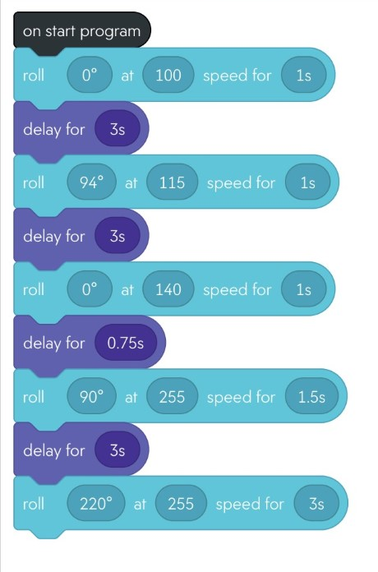
Sprint 3: Agility

